Slide 1
Tutorial 3 – More Scripting & FastQC
25 September 2020
MICB405

Slide 2
What is FASTQC?
Program that generates an HTML report of FASTQ files that you provide it
Generally used for whole-genome shotgun sequencing output
Less reliable for other kinds of sequencing output like mRNA-Seq, RNA-Seq, ChIP-seq, etc…

Slide 3
Why FASTQC?
Quick, informal statistics on FASTQ files coming out of a sequencing environment
Can indicate generally if something is drastically wrong with your FASTQ read output
Output should be taken with a grain of salt
Thresholds for warnings are not going to be calibrated to your experiment necessarily
Will take into account Illumina vs other sequencing technologies from the read names

Slide 4
Where is FASTQC?
It’s already in your $PATH (yay!)
Bash already knows where to look when you call fastq
Try echo $PATH to see the directories (in order of priority) where bash looks for programs to run, as well as other programs that you can run!
This is just for fun

Slide 5
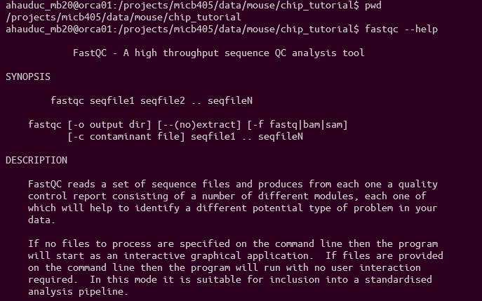
Using FASTQC

Slide 6
Grabbing the files for viewing with scp
You need to get your html files into an environment with a graphical user interface
In other words, out of the command line interface?
Details vary depending on operating system but usually involve SCP
Must almost always be in your machine’s terminal
PuTTY users need to use pscp
scp ahauduc_mb20@orca1.bcgsc.ca:/home/ahauduc_mb20/fqc_output/* .

Slide 7
Where to find files on your computer after SCP
Windows WSL -> File Explorer (to get to your Linux partition directory)
\\wsl$\Ubuntu\home\<your Unix username>\
Windows Git Bash -> File Explorer
C:\Users\<your Windows username>\
macOS -> Finder
/Users/<your macOS username>
PuTTY

Slide 8
Demonstration

Slide 9
How to interpret the FASTQC output

Slide 10
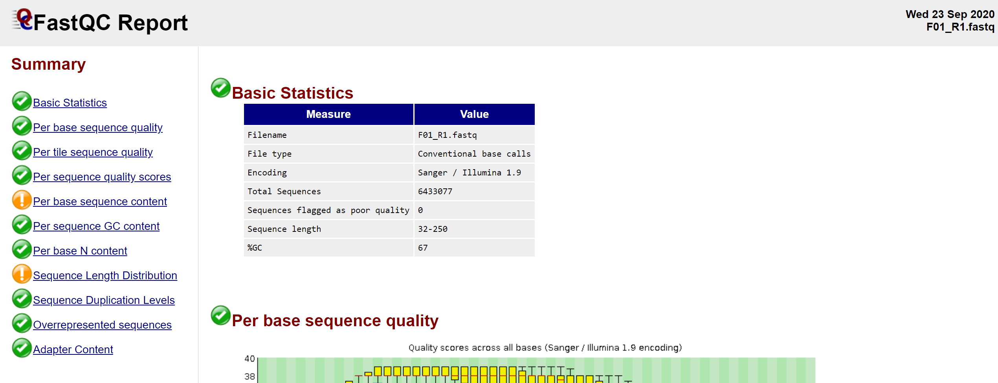
How to interpret a FASTQC report

Slide 11
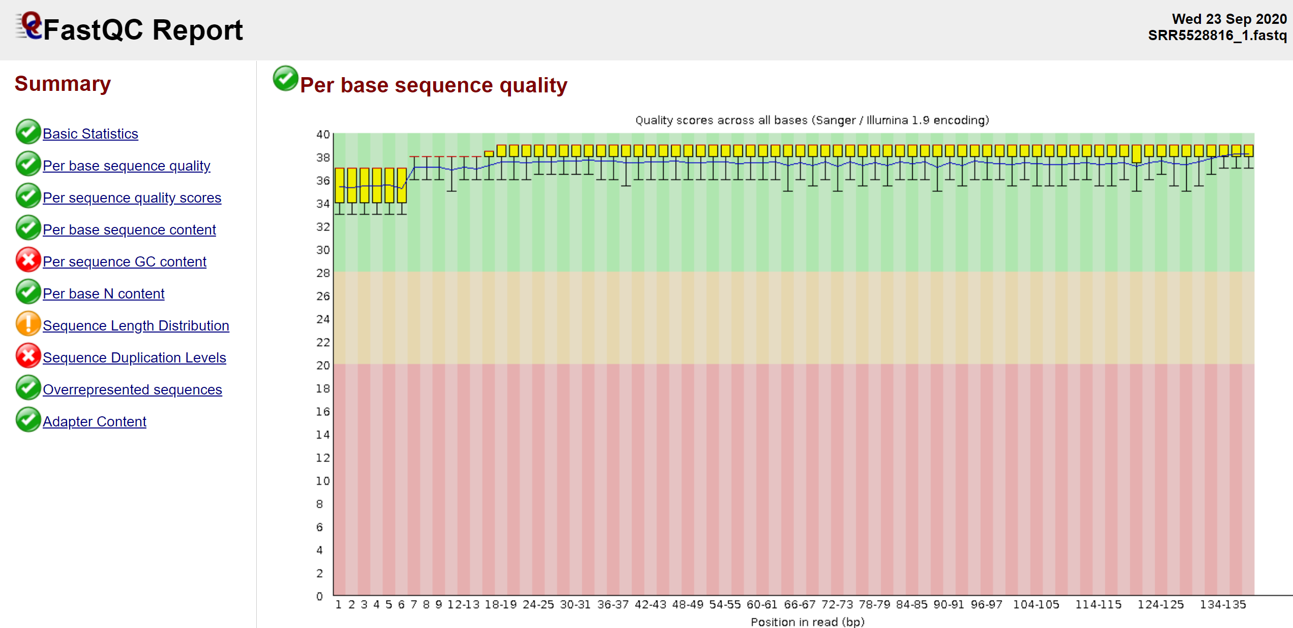
Notes:
Here, you should expect to see average quality at all the bases to be generally consistent, and high.
If there is

Slide 12
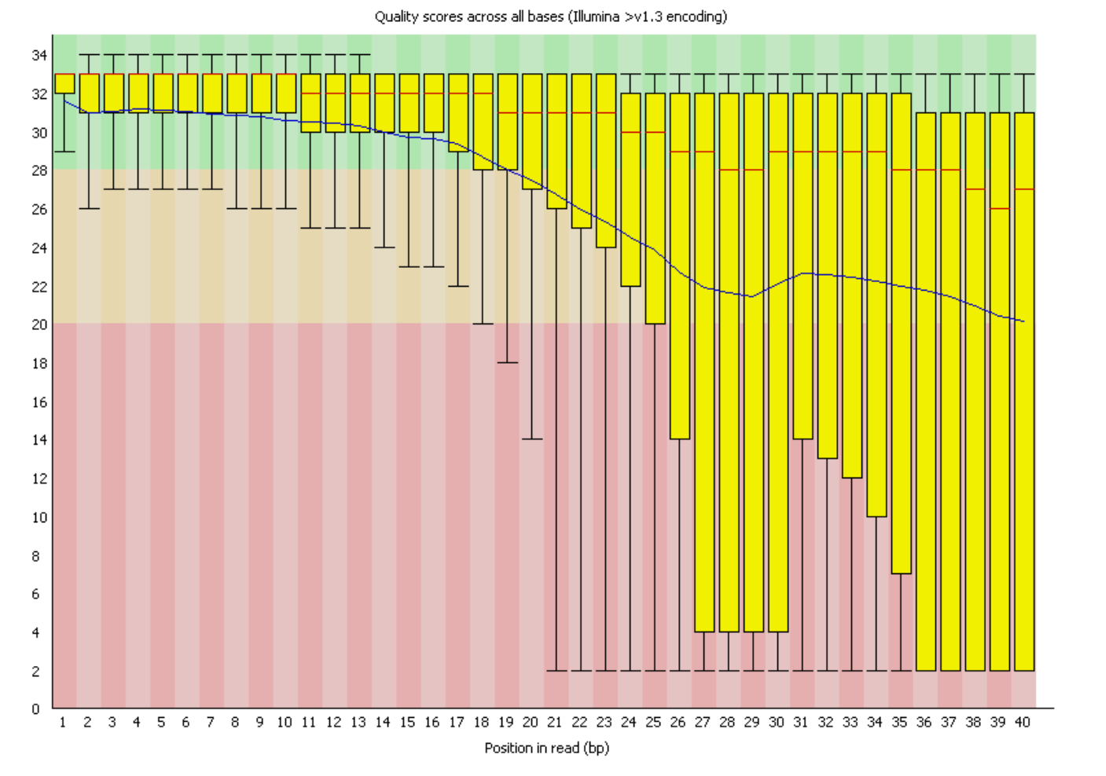
Low-quality example!

Slide 13
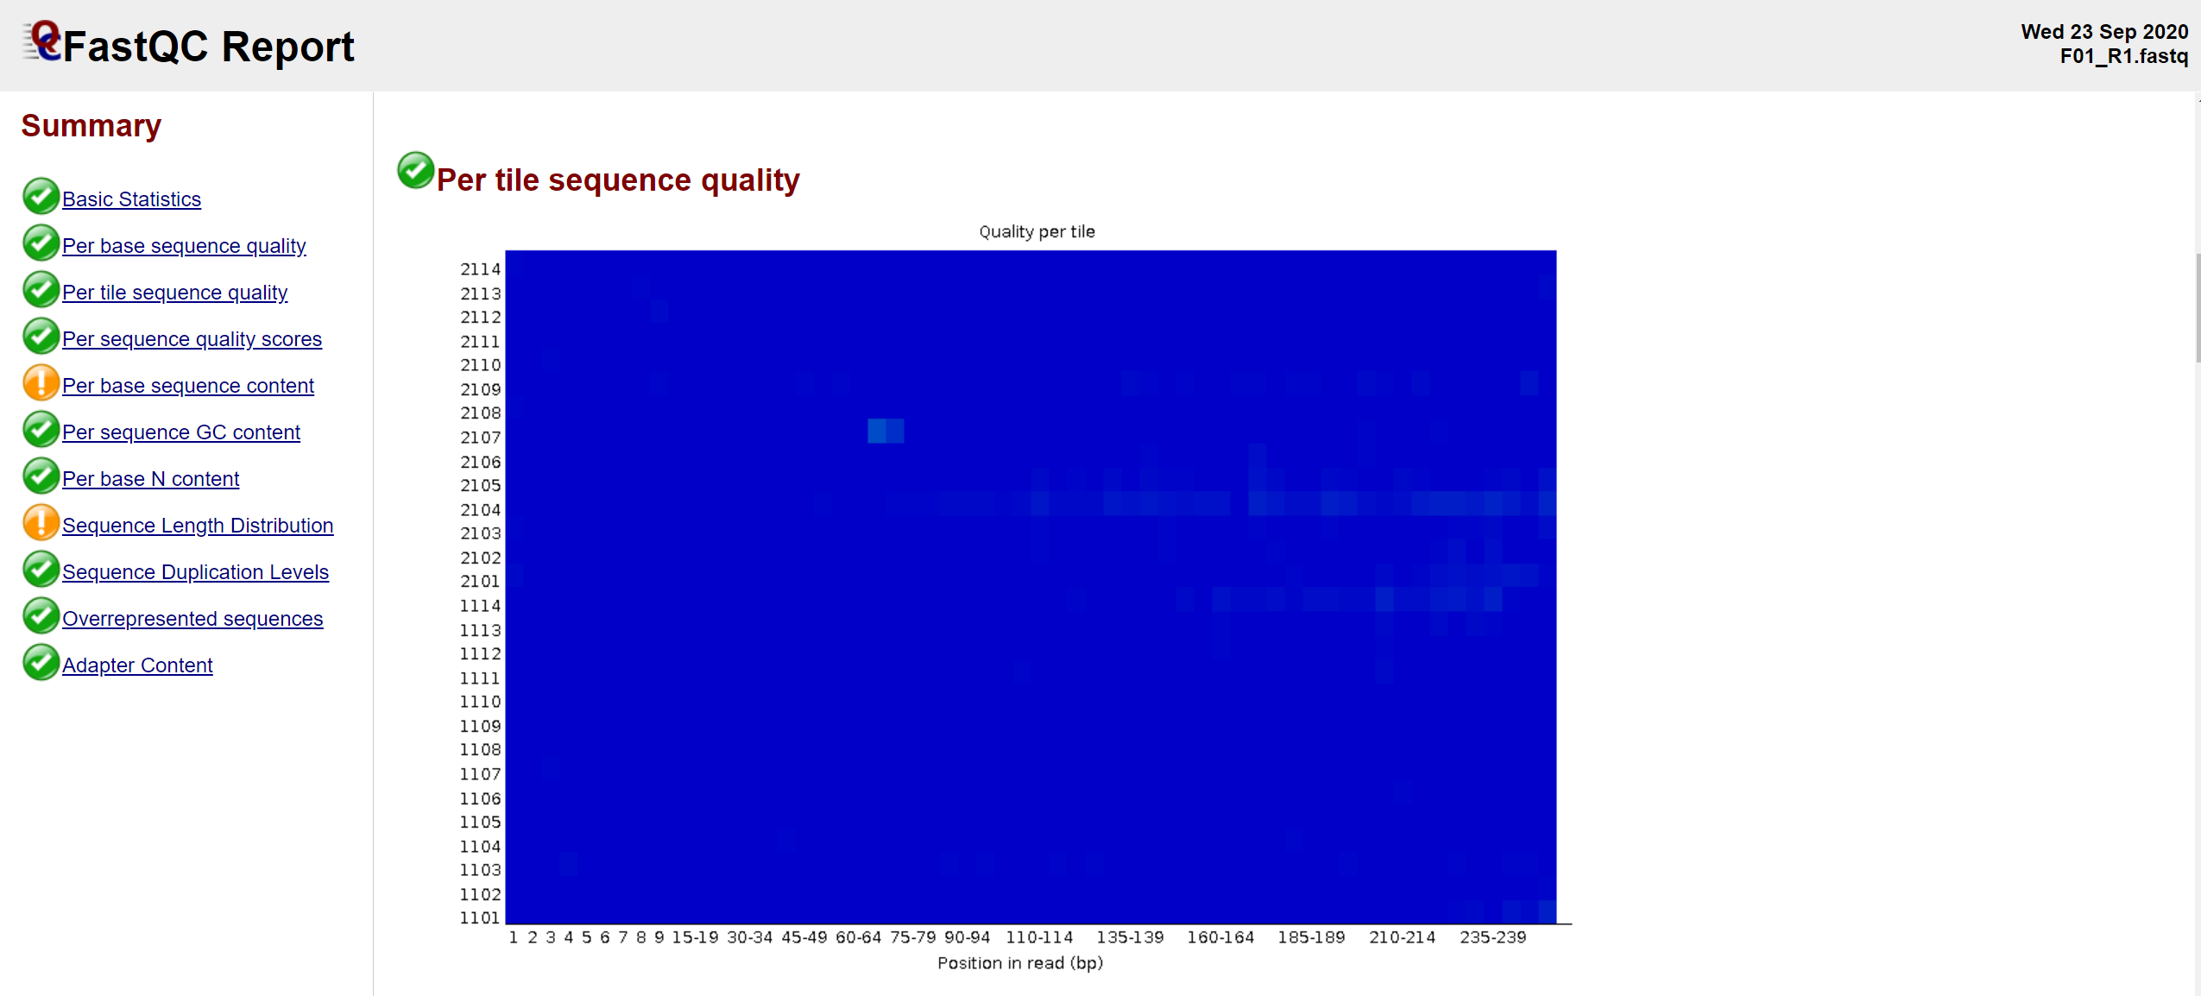

Slide 14
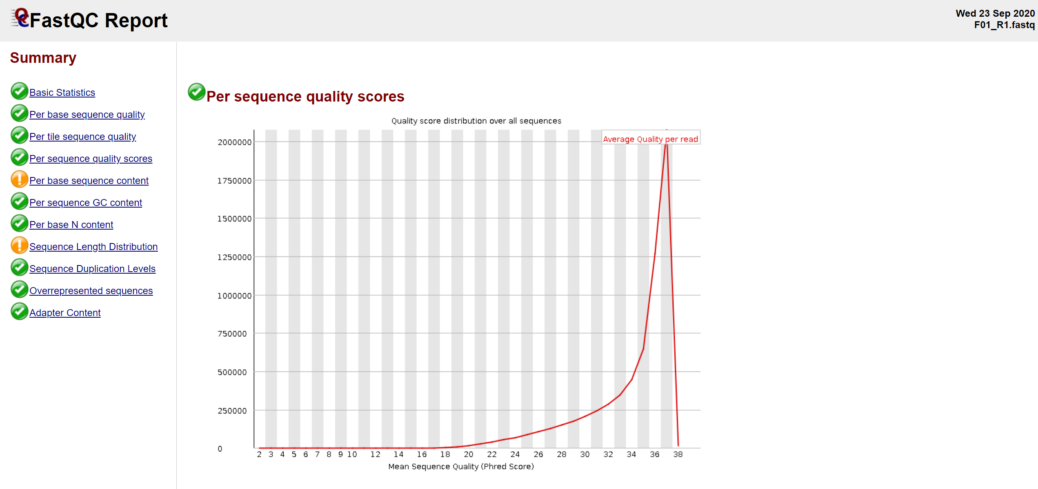
Notes:
Warning A warning is raised if the most frequently observed mean quality is below 27 - this equates to a 0.2% error rate.
Failure An error is raised if the most frequently observed mean quality is below 20 - this equates to a 1% error rate.

Slide 15
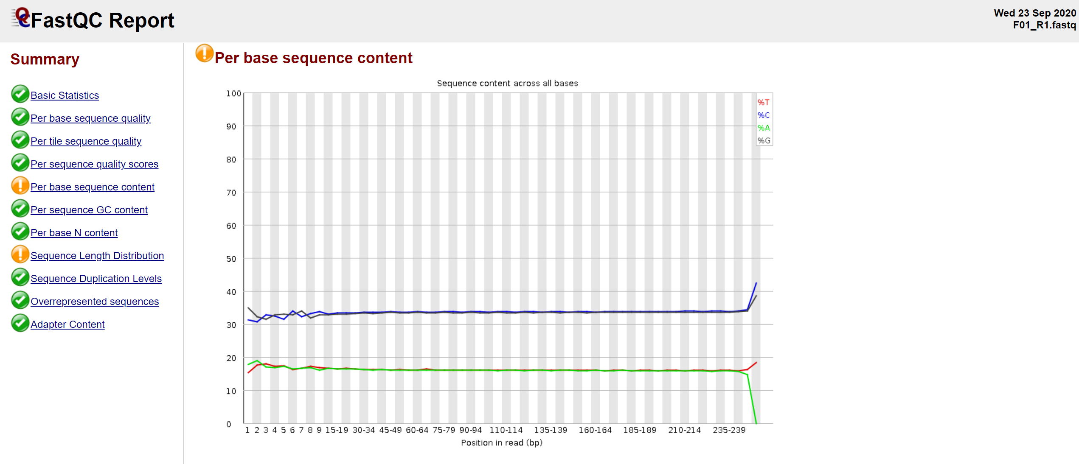
Notes:
This module issues a warning if the difference between A and T, or G and C is greater than 10% in any position.

Slide 16
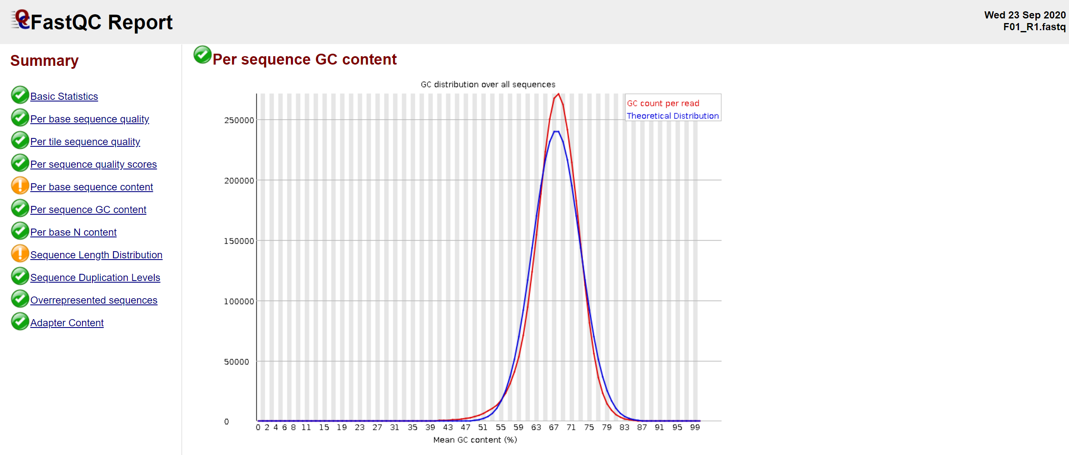

Slide 17
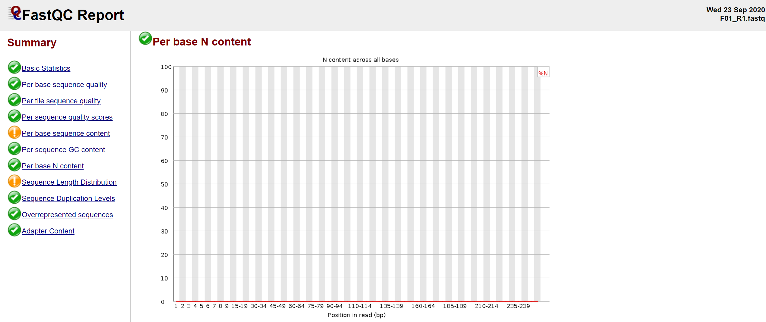

Slide 18
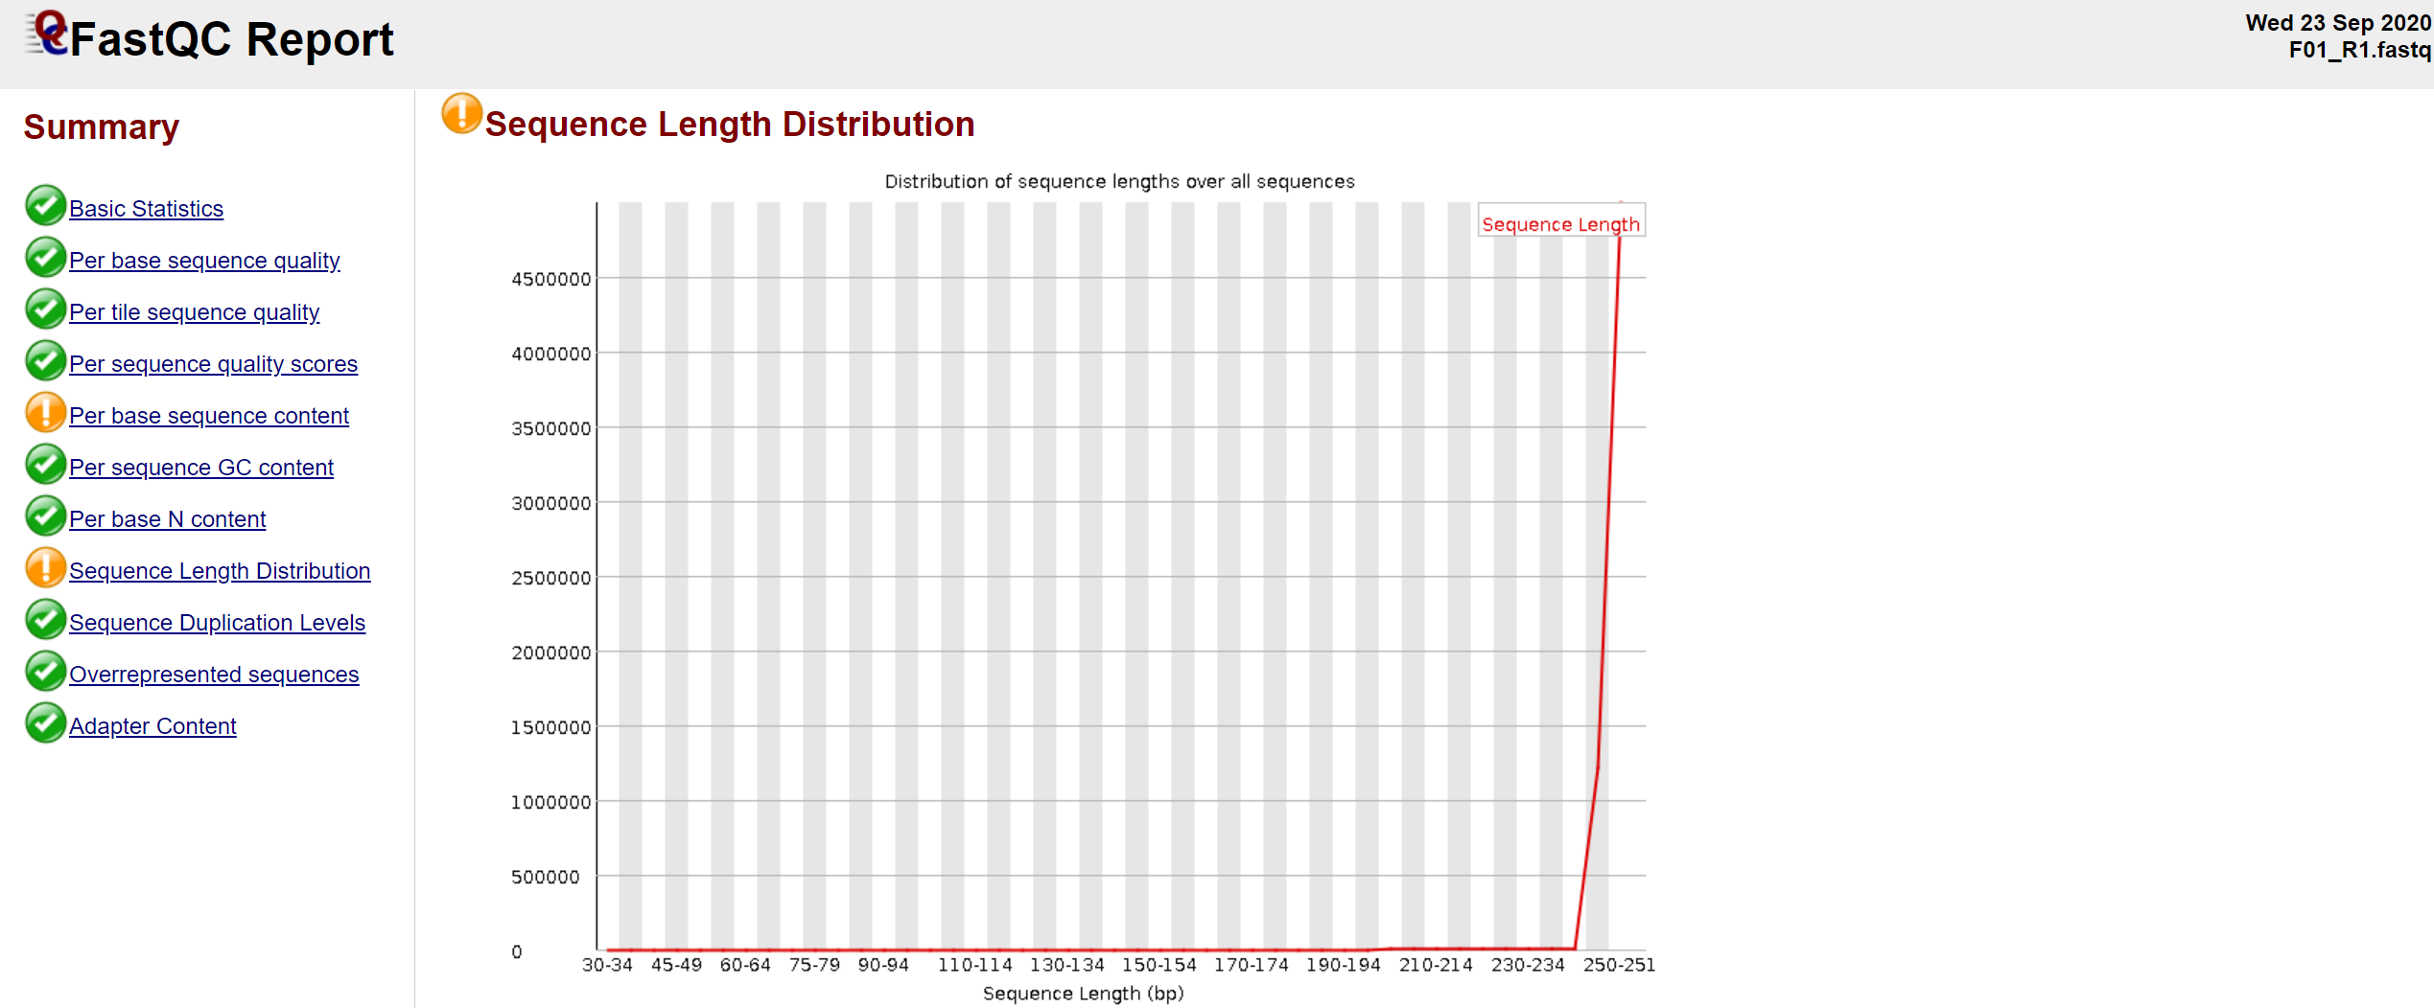

Slide 19
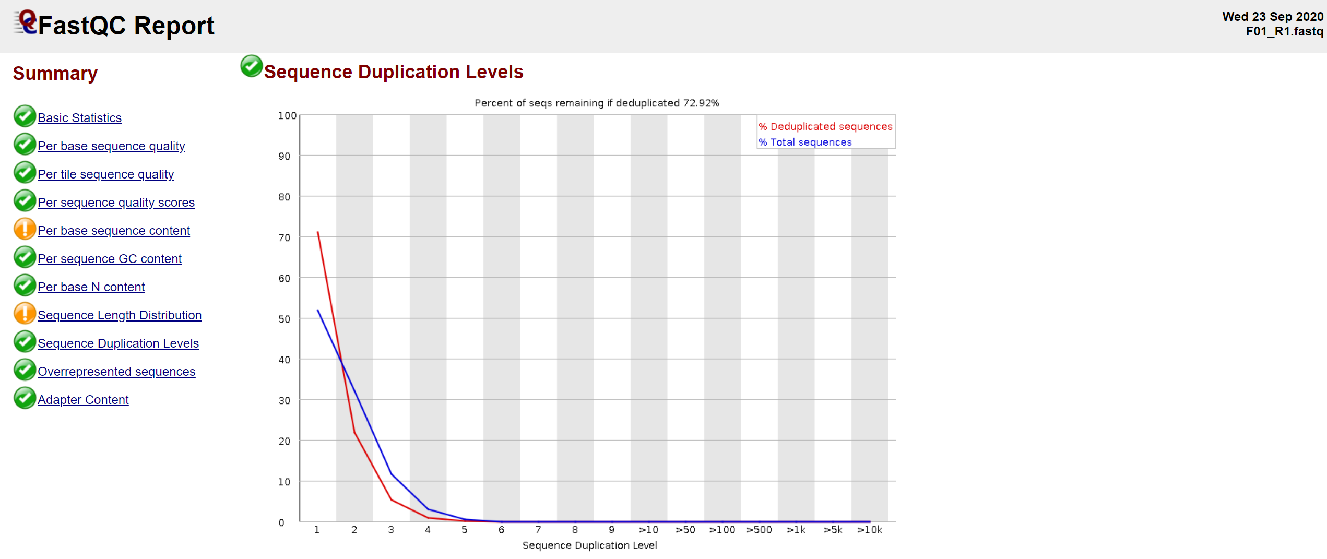

Slide 20
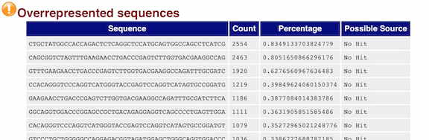

Slide 21
